Slide 1
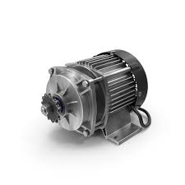

Working of BLDC Motor
Understanding the Principles and Applications of Brushless DC Motors

Slide 2

What is a BLDC Motor?

Slide 3
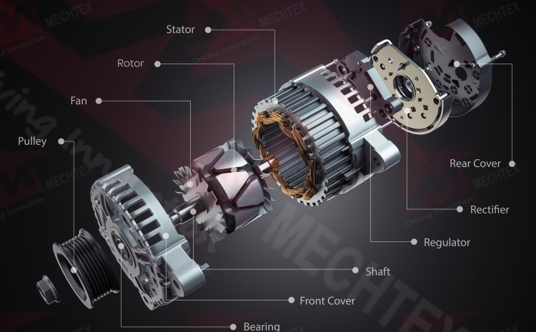
A BLDC Motor stands for Brushless DC Motor.
https://mechtex.com/blog/introduction-of-bldc-motor

Slide 4
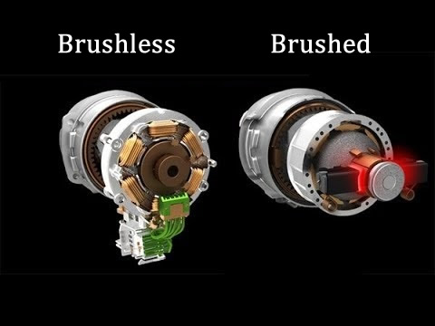
Difference between Brushed and Brushless Motors
https://interestingengineering.com/innovation/the-difference-between-brushed-and-brushless-motors

Slide 5
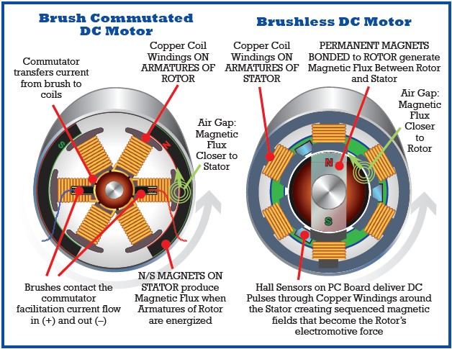
https://www.haydonkerkpittman.com/learningzone/blog/2023/august/what-is-the-difference-between-a-brush-and-a-brushless-motor

Slide 6
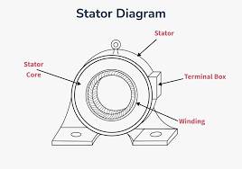
Basic Construction of BLDC Motors
Stator: Stationary part with windings

Slide 7
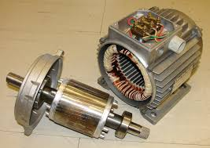
Rotor: Rotating permanent magnets
https://simple.wikipedia.org/wiki/Rotor_%28electric%29

Slide 8
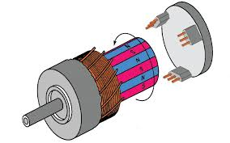
Hall Sensors: Detect rotor position
https://docs.simplefoc.com/hall_sensors

Slide 9
Types of BLDC Motors
Inner Rotor BLDC Motor: Rotor inside, stator outside
Outer Rotor BLDC Motor: Rotor outside, stator inside
Applications vary based on speed, torque, and size requirements

Slide 10
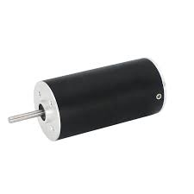
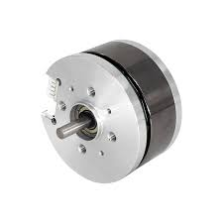
Inner Rotor BLDC Motor
Outer Rotor BLDC Motor
https://www.chaoyamotor.com/55mm-outer-rotor-brushless-dc-motor-for-robots.html
https://www.alibaba.com/product-detail/Hot-Sale-Low-Cost-28mm-Inner_1600693353750.html

Slide 11
Working Principle of BLDC Motor
Magnetic Field Generation: Current flows through stator windings creating a rotating magnetic field
Rotor Alignment: Permanent magnets on rotor align with stator field
Electronic Commutation: Controller switches current between phases based on rotor position
Hall Effect Sensors: Feedback system for precise control

Slide 12
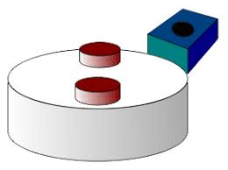
Role of Hall Sensors in BLDC Motor
Detect magnetic field changes
Send rotor position data to controller
Ensure correct timing for phase switching
Enables closed-loop feedback for accurate speed control
https://en.wikipedia.org/wiki/Hall_effect_sensor

Slide 13
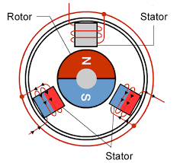
Advantages of BLDC Motors
Higher efficiency and power output
Reduced electromagnetic interference (EMI)
Compact and lightweight design
Better heat dissipation
https://www.renesas.com/en/support/engineer-school/brushless-dc-motor-01-overview

Slide 14
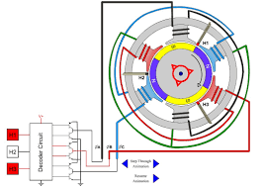
Applications of BLDC Motors
Drones and UAVs: High thrust-to-weight ratio
Electric Vehicles (EVs): Efficient propulsion systems
Industrial Automation: Conveyor belts, robotics
Home Appliances: Fans, pumps, compressors
Medical Devices: Surgical tools, ventilators
https://electricalbaba.com/brushless-dc-bldc-motor/

Slide 15

Hands-on Activities
Activity 1: Connecting a BLDC motor to an Arduino
Activity 2: Using an ESC (Electronic Speed Controller) to control a BLDC motor
Activity 3: Reading Hall sensor data for position feedback

Slide 16


